Slide 1
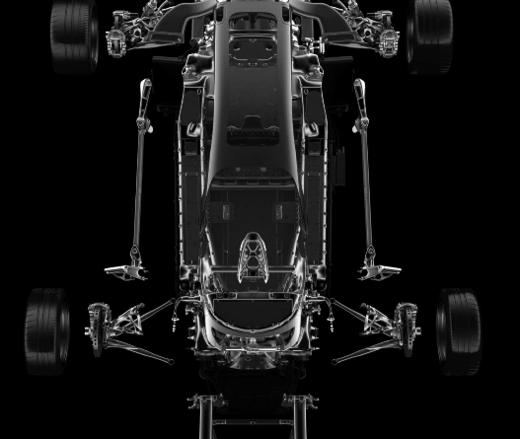
Capstone Project : Automotive Industry
Group B-3 Aman Bhardwaj Priya Bhardwaj Tanisha Jain Satyam Sharma

Slide 2
Content
Problem Statement Discussion
Challenges
Task 1
Task 2 Task 3 Next Steps

Slide 3
Problem statement
XYZ company aspires to enter the US used car market
Based on the dataset of different types of used cars across the market:
List the output of exploratory analysis.
Highlight important outcomes/findings from the data by descriptive analysis.
Build an appropriate predictive model for predicting the price of a used car.

Slide 4
Challenge
Problem faced by the Company
The XYZ Company want to understand the factors affecting the pricing of cars in the market, since those may be very different from the new car market. Essentially, the company wants to know:
Which variables are significant in predicting the price of a used car?
How well those variables describe the price of a car?

Slide 5
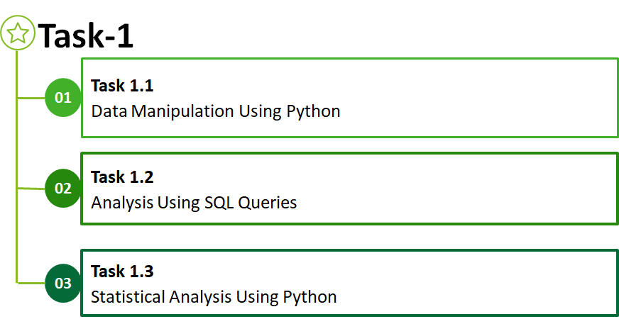

Slide 6

Data Manipulation Using Python

Slide 7
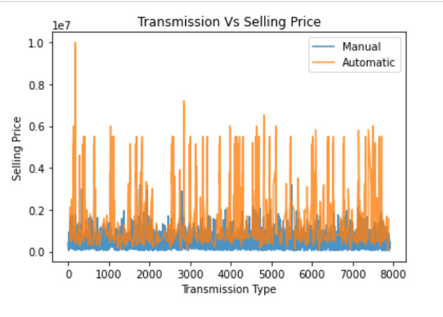
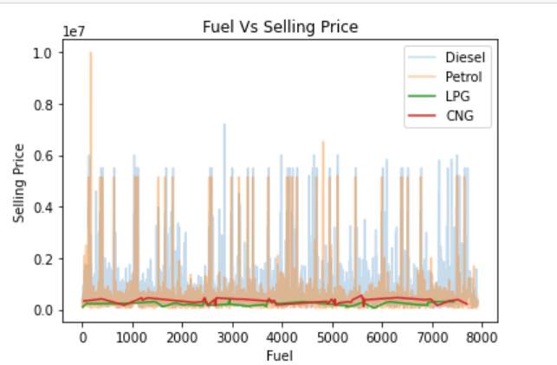
Which variables are significant in predicting the price of a used car?
Using various data manipulation method using python to understand the variables which are significant in predicting the price of a used car

Slide 8
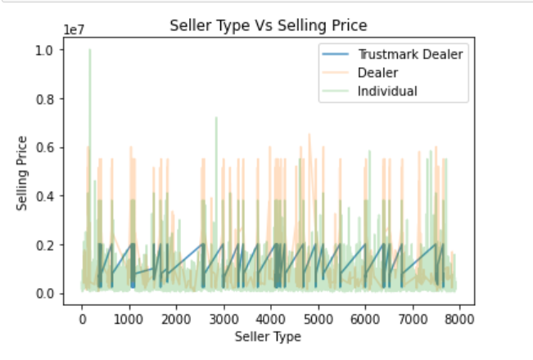
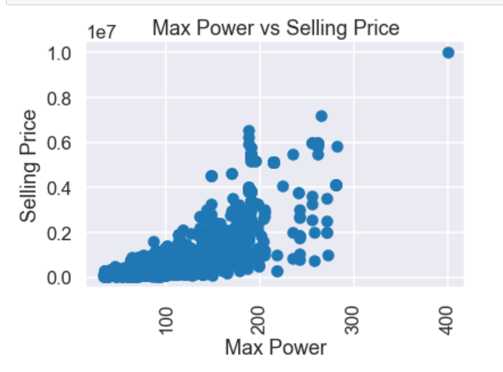
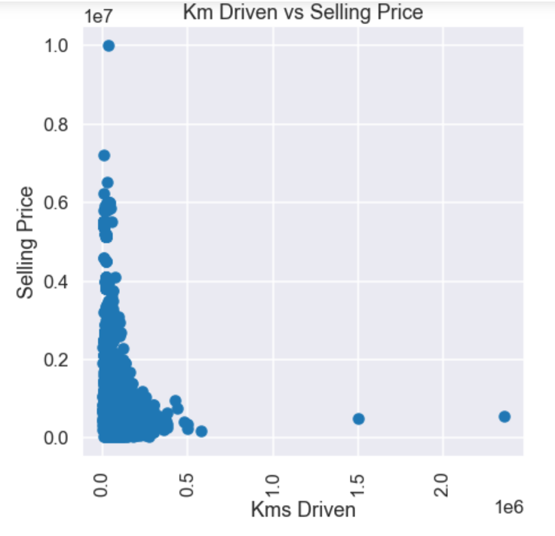
Other variables that are significant in predicting the price of used car.

Slide 9
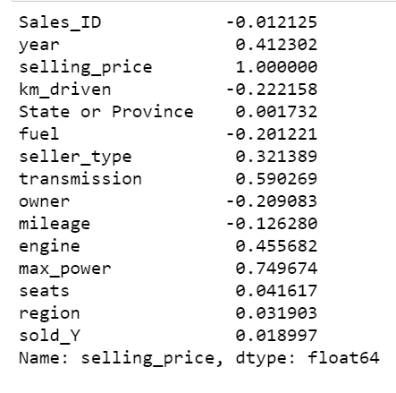
How well the variables describe the price of a car?
Coefficient of correlation is an extensively used mathematical method in which the numerical representation is applied to measure the level of relation between linearly related variables.
In the data correlation along side, we can see that max power, engine(volume), year(of manufacturing) and transmission type have a positive increase in the selling price of the car and the values indicating a good correlation.
The other attributes namely kilometer driven, and owner type have negative effect on the selling price and the values indicating has low correlation

Slide 10
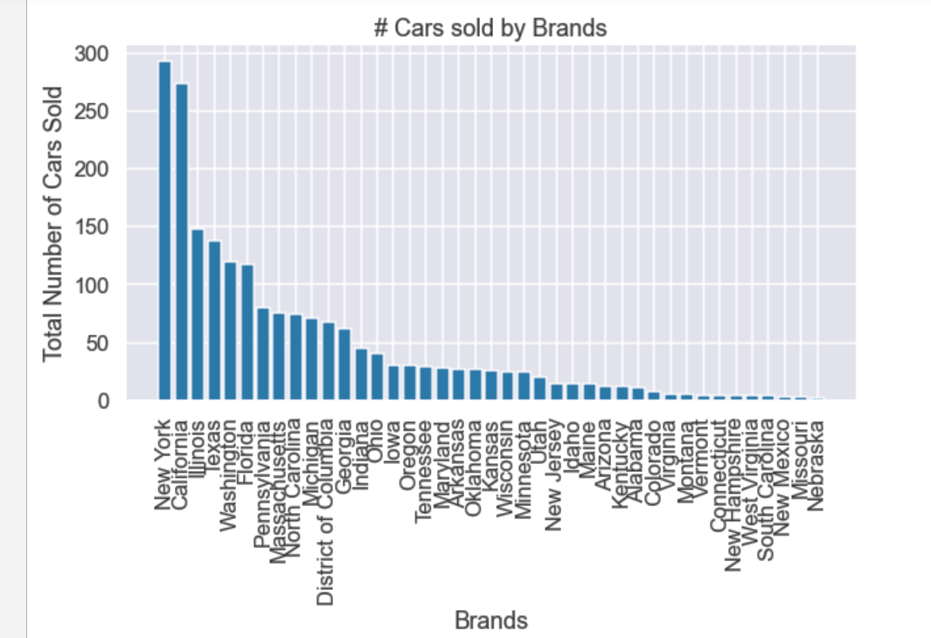
Which brands are selling the most?

Slide 11
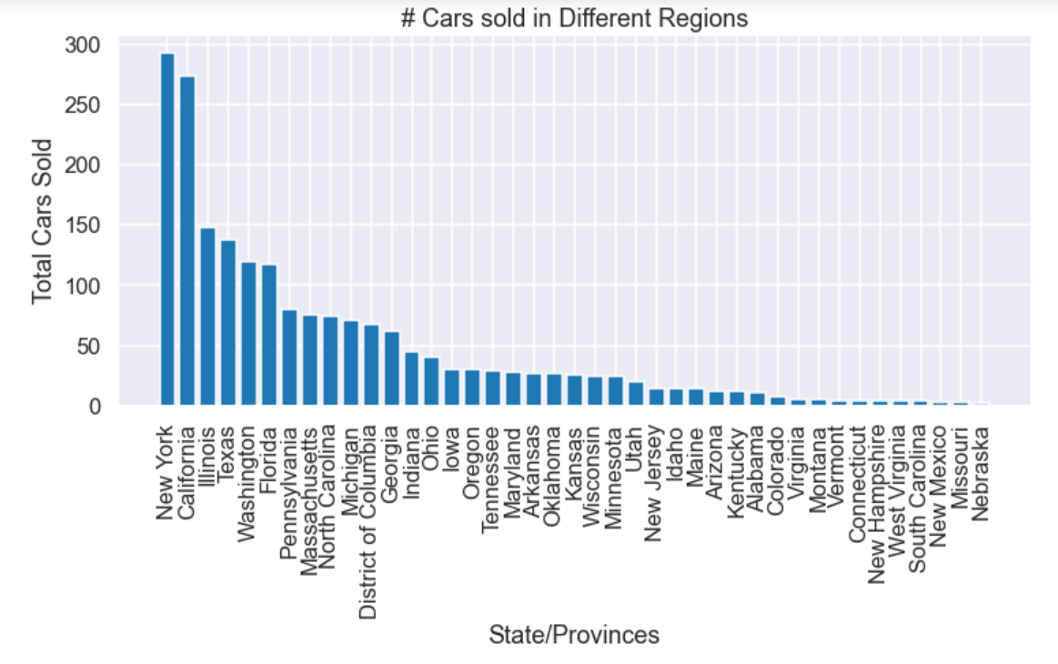
Specific locations selling more

Slide 12

Analysis using SQL Queries

Slide 13
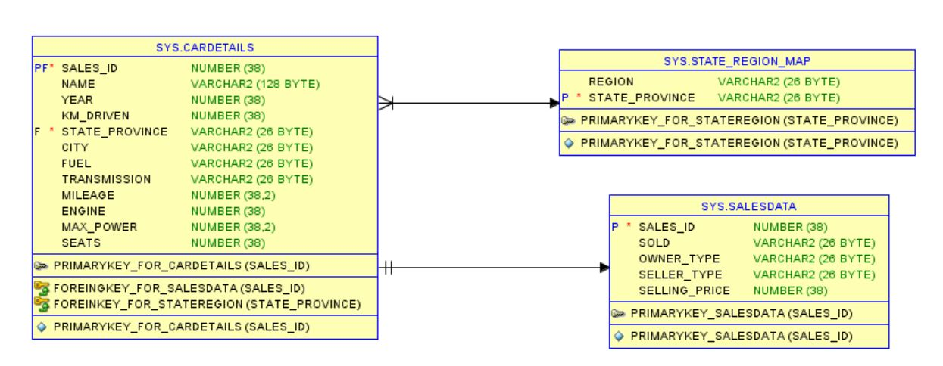
ER Diagram

Slide 14
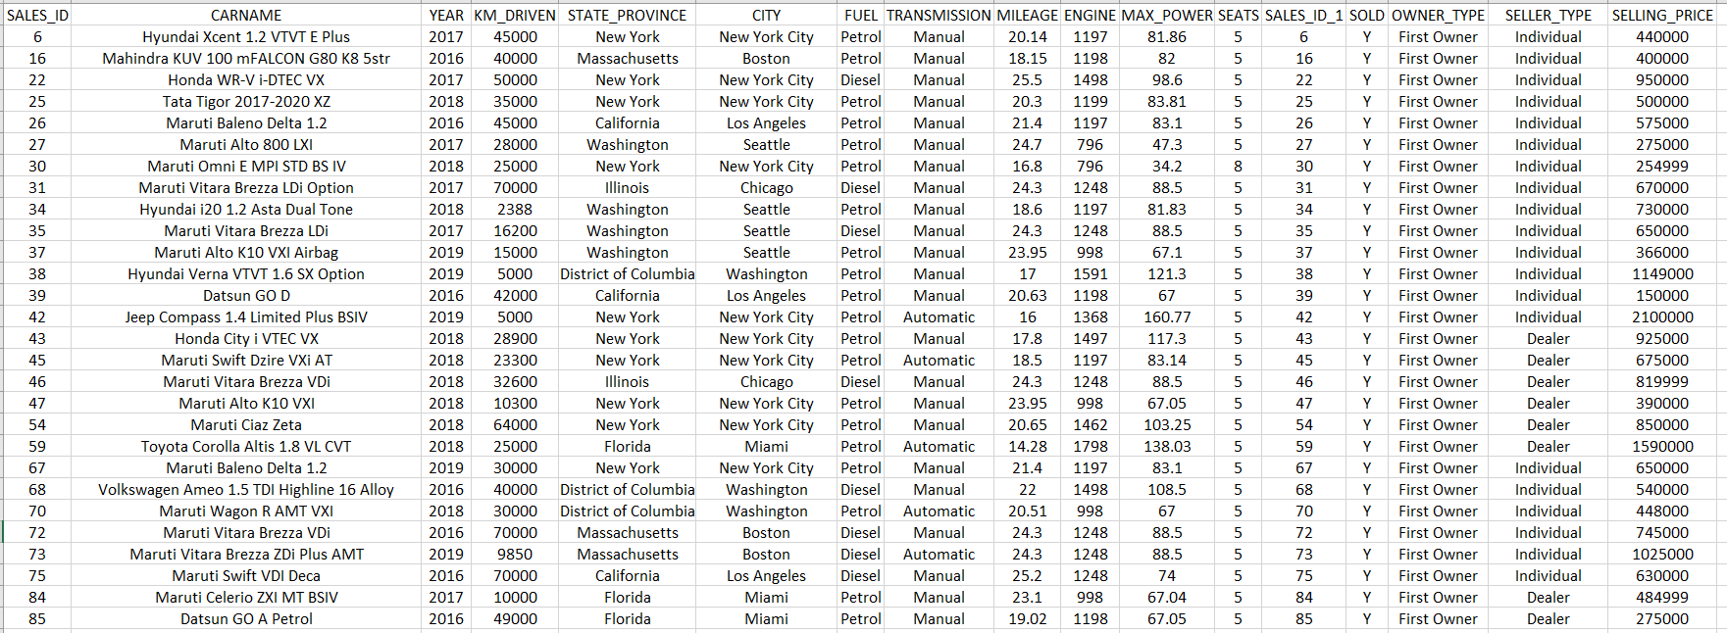
SQL Query 1
Generate Info of the cars which is of the type first owner and the year of car purchase is between 2016-2020 and the number of kms driven is less than 80,000
1

Slide 15
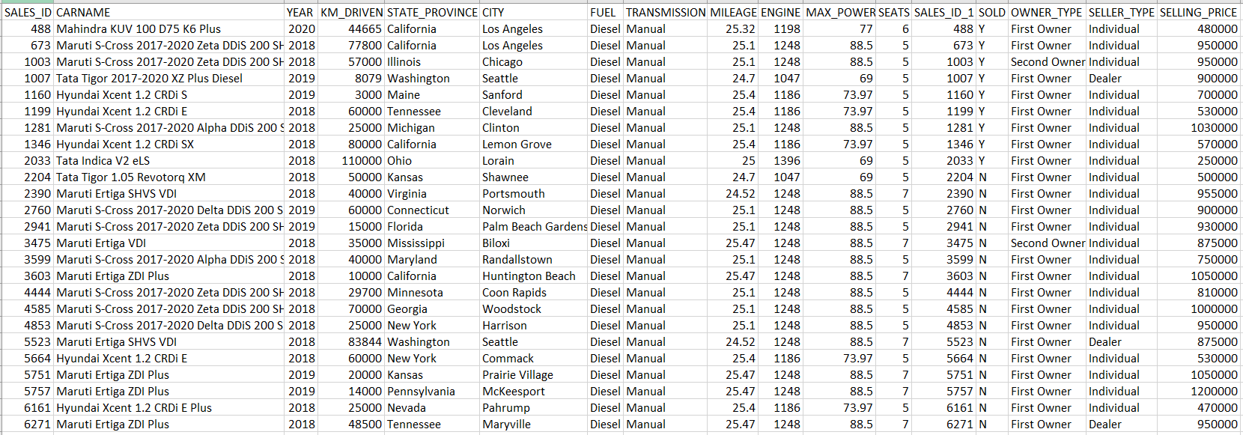
SQL Query 2
Generate Info of all the cars whose average mileage is around 25 kmpl and year of car purchase is between 2018-2020 which has minimum seating of 4-5 and fuel type is diesel.

Slide 16
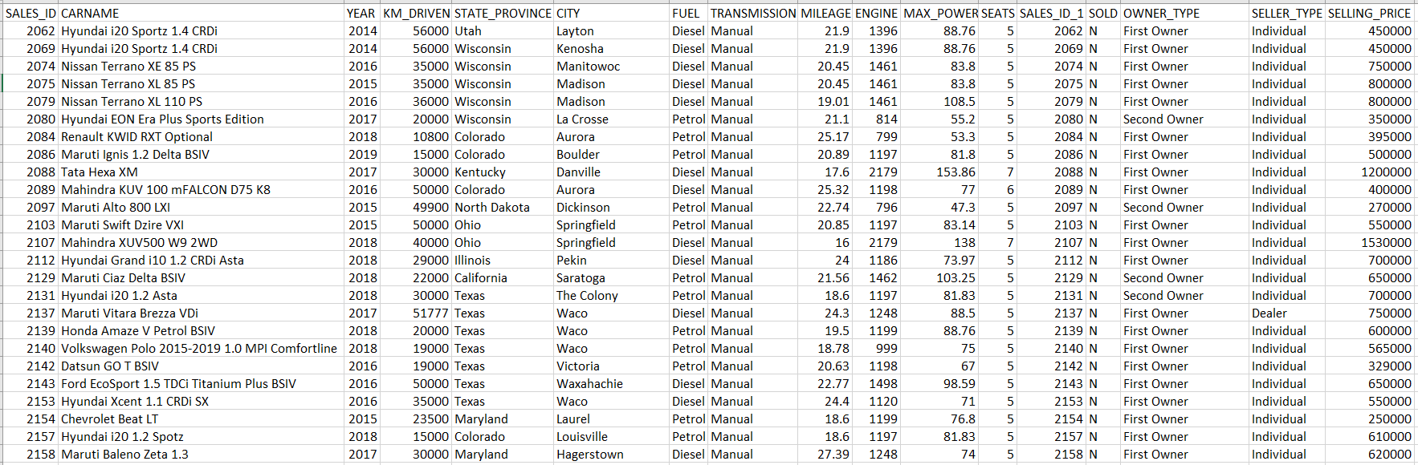
SQL Query 3
Generate Info of all the cars which are not sold, and seller-type is individual or dealer and also which has been used for less than 60000 kms and year of car purchase is 2014-2020.

Slide 17
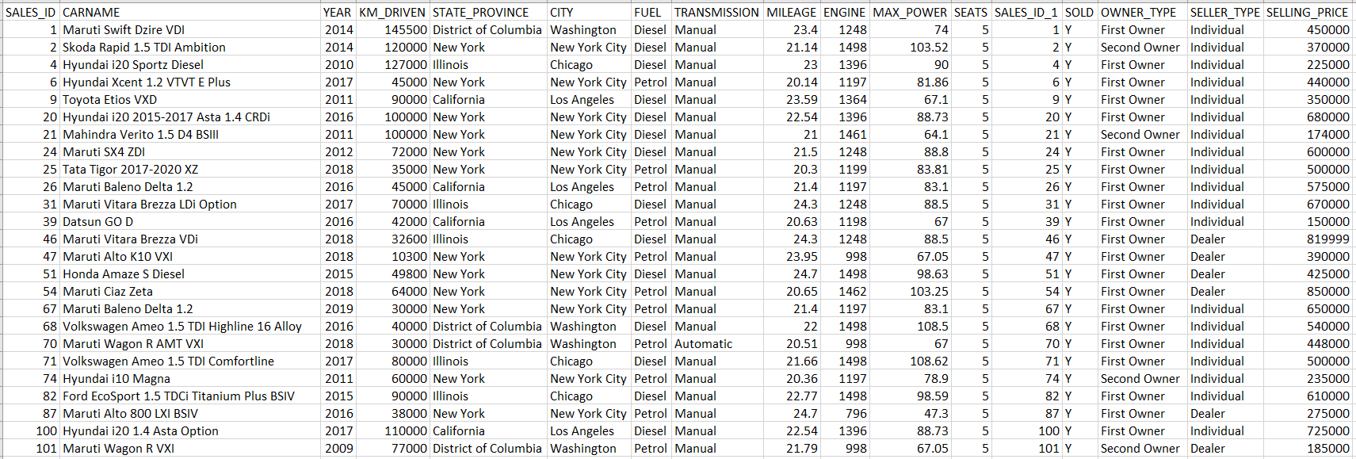
SQL Query 4
Generate Info of all the cars which are manual and automatic whose mileage ranges between 20-25kmpl approximately and also which is within these cities(Washington, New York City, Chicago, Los Angeles)

Slide 18
SQL Query 5
Generate Info of all the cars which belong to Honda category could be either first owner and second owner and also fuel type is petrol and average mileage should be 25 kmpl and which are not sold and seating arrangement should be minimum 4.
No output matching the above constraints.

Slide 19
Statistics using Python

Slide 20
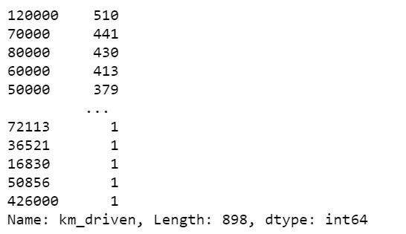
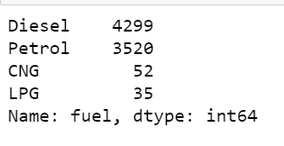
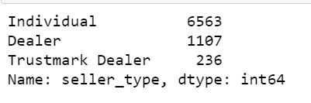
Descriptive Analysis
For Kilometer Driven
For Fuel Type
Similarly analyzed for other attributes.
Conclusion:
Discrete/Categorical Year, State or Province, Seller Type, Seats, Brands, Sold
Continuous Kilometer driven, Mileage, Engine(Size), Max Power
For Seller Type

Slide 21
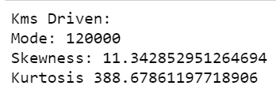
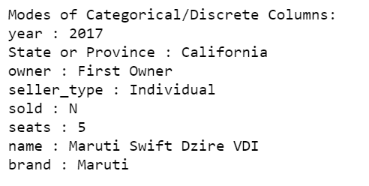
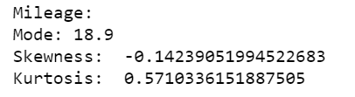
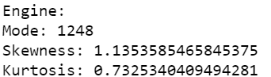
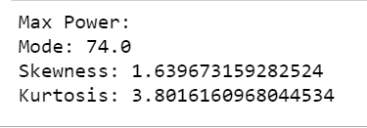
Mode, skewness and Kurtosis
For Continuous Attributes
For Categorical Attributes

Slide 22
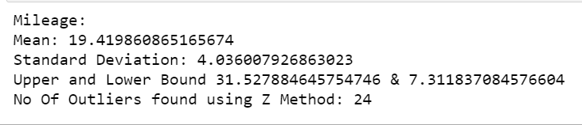
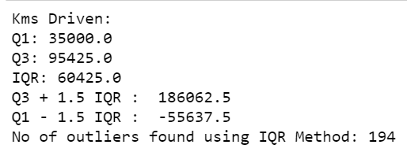
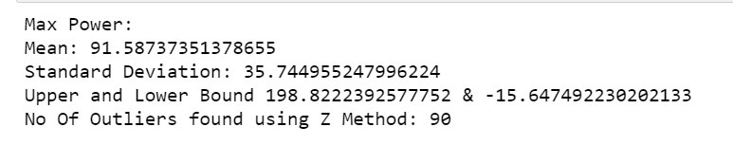
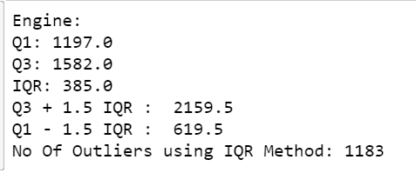
Outlier Analysis
Using Z Score Method
Using IQR Method
For Mileage
For Kilometer Driven
For Max Power
For Engine

Slide 23
Hypothesis Testing(Z-Test)
Using Z-Test on the Brand to see whether the assumed null hypothesis is valid.
H0: Maruti accounts for 30% of the cars sold. H1: Maruti does not account for 30% of the cars sold.
P-Value = 0.8834. Since the p-value is greater than the level of significance(α=0.05) we accept the null hypothesis.

Slide 24
Hypothesis Testing(Chi-Square Test)
Chi-Square test on Region and Year of the already sold cars to find if the two attributes have association
H0: Region and Year for already sold cars have no association. H1: Region and Year for already sold cars have no association.
P-Value = 0.6115. Since p-value is not close to 0 we accept the null hypothesis.

Slide 25
Task 2.1
Perform indicative analysis on the given data
Perform Visualization using Python
Infer appropriate results from the Visualization
Perform Univariate, Bi-Variate and Multivariate Analysis
Missing Values and Outlier Analysis and treatment
Data Scaling and Transformation
Feature Engineering
Task 2.2
Task 2.3
Use Power BI and perform Data Manipulation using Power Query Editor
Build visualization for the given tasks and produce insights
Task 2.4
Build and Compare ML models on the data with appropriate regularization and hyperparameter.
Identify right metric to evaluate the performance of the model.

Slide 26

Visualization using Python

Slide 27
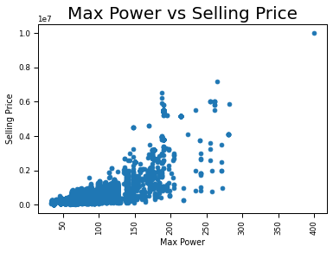
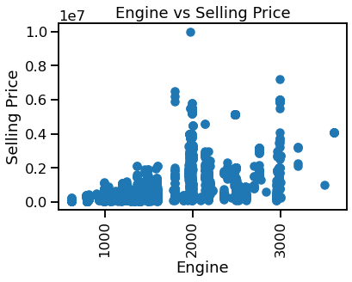
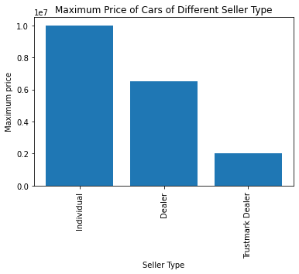
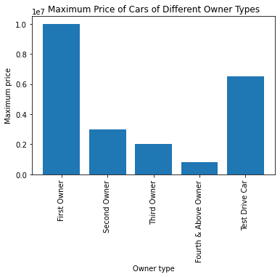
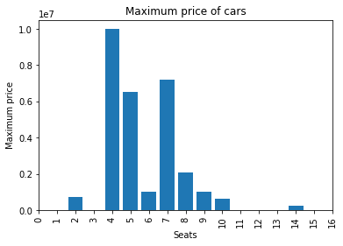
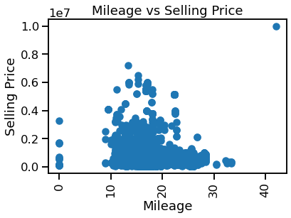
Variables Describing Selling Price

Slide 28
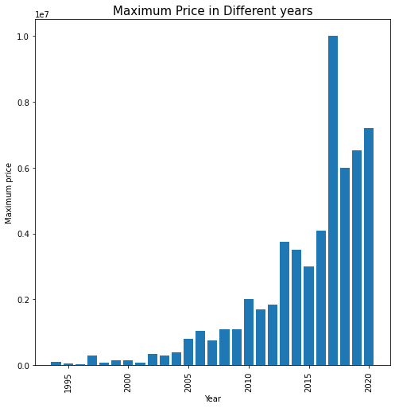
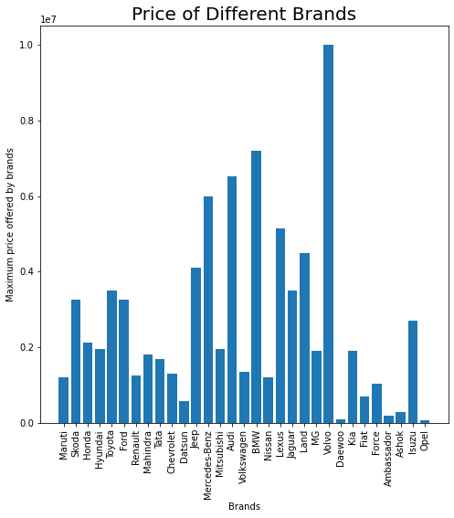
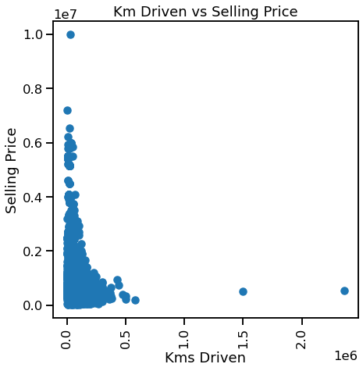
Variables Describing Selling Price(contd.)

Slide 29
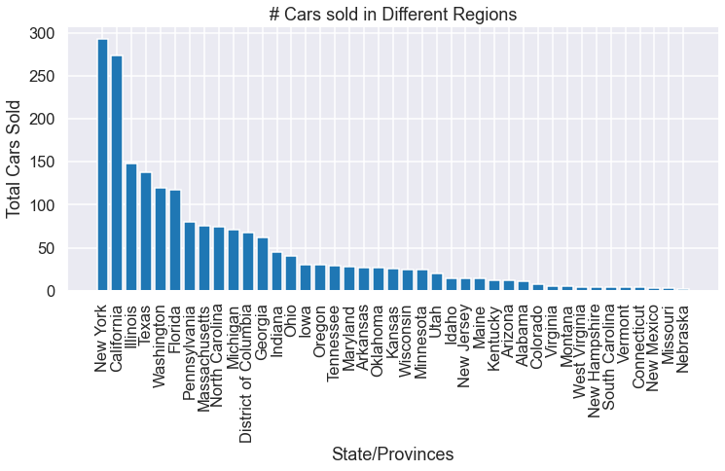
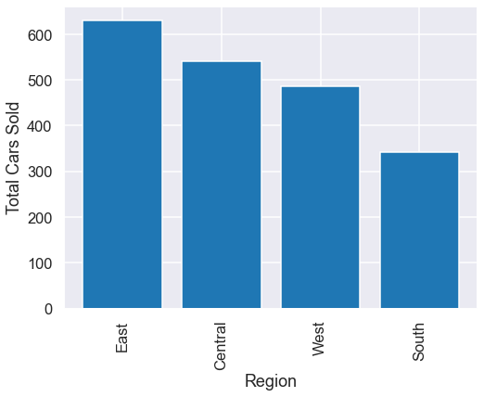
Specific locations selling more

Slide 30
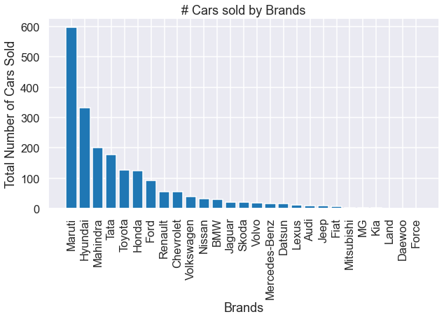
Brands Selling The Most Cars

Slide 31
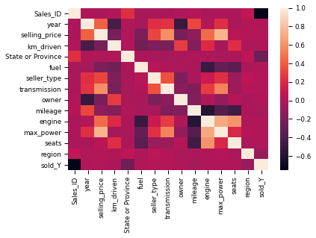
Heatmap to show Correlation of variables with Selling Price

Slide 32

Exploratory Data Analysis

Slide 33
Missing Value Identification and Treatment
Missing value treatment
There were no missing values found in the data set.
However, there were records in our dataset which had mileage 0.
We took the average of the mileage for each Brand and substituted the 0 mileage of the respective records.

Slide 34
Outlier Analysis (contd.)
Kilometer Driven Outlier Analysis
Kilometer driven outlier analysis using IQR method resulted in 194 outliers.
Analyzing the outliers gave us the insight that those vehicles were mostly diesel driven having 5 or 7 seats.
Mileage Outlier Analysis
Mileage outlier analysis using Z-score method resulted in 7 outliers.
The outliers are mainly CNG fueled cars from first and second owners.

Slide 35
Outlier Analysis (contd.)
Max Power Outlier Analysis
Max power outlier analysis using Z-score method resulted in 90 outliers.
The outliers are mostly first owner luxury vehicles, having automatic transmission having high engine displacement and seating of mainly 5 or 7.
Engine Displacement Outlier Analysis
Kilometer driven outlier analysis using IQR method resulted in 1183 outliers.
The outliers are mainly SUVs and luxury diesel vehicles having low average mileage, high power and with seating of 7 or more.

Slide 36
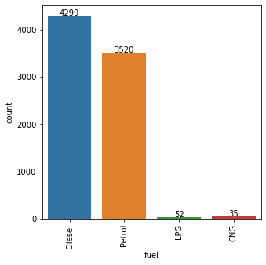
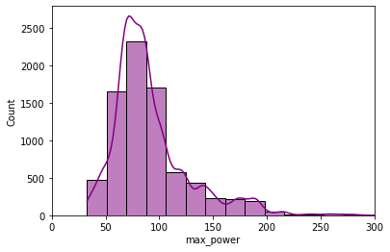
Univariate Analysis
Countplot for Fuel Type
Histplot for Max Power

Slide 37
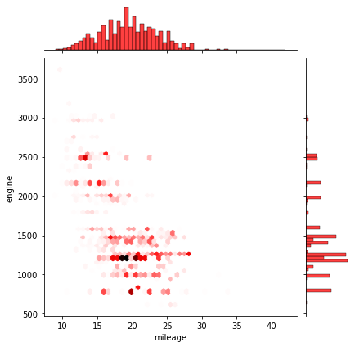
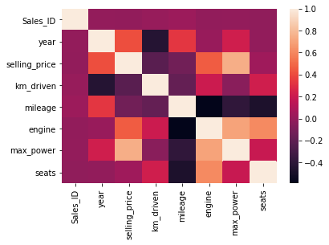
Bivariate Analysis
Jointplot of Engine v Mileage
Heatmap

Slide 38
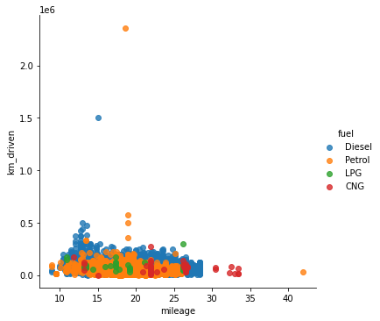
Multivariate Analysis
Scatterplot of Kilometer Driven v Mileage with Fuel as legend

Slide 39
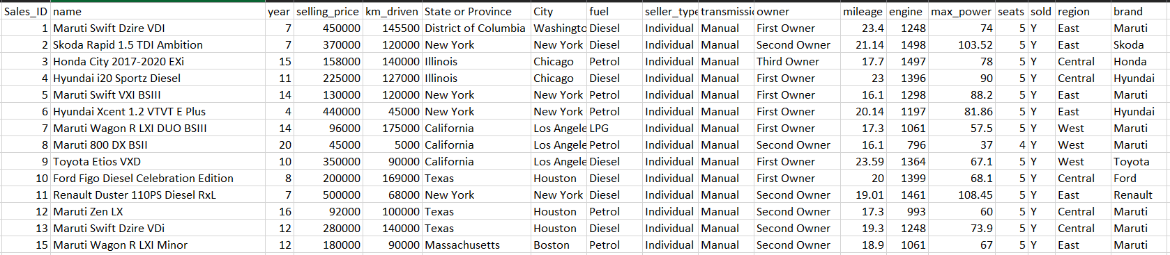
Feature Engineering
Extracting brands from the car names to extract common features for each brand.
Converting the years attribute to the difference of the year bought and the present year, so that it can be visualized if there is a relation between the selling price and the increasing years.

Slide 40
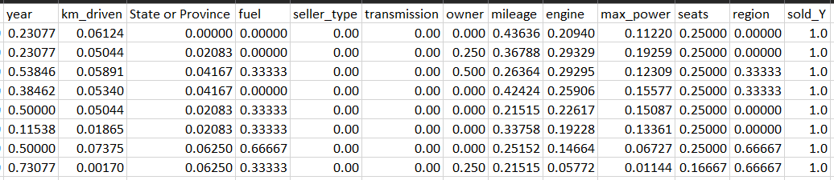
Data Scaling and Transformation
Using MinMaxScaler to scale the numerical data in the range between 0 and 1.

Slide 41

Storytelling using Power BI

Slide 42
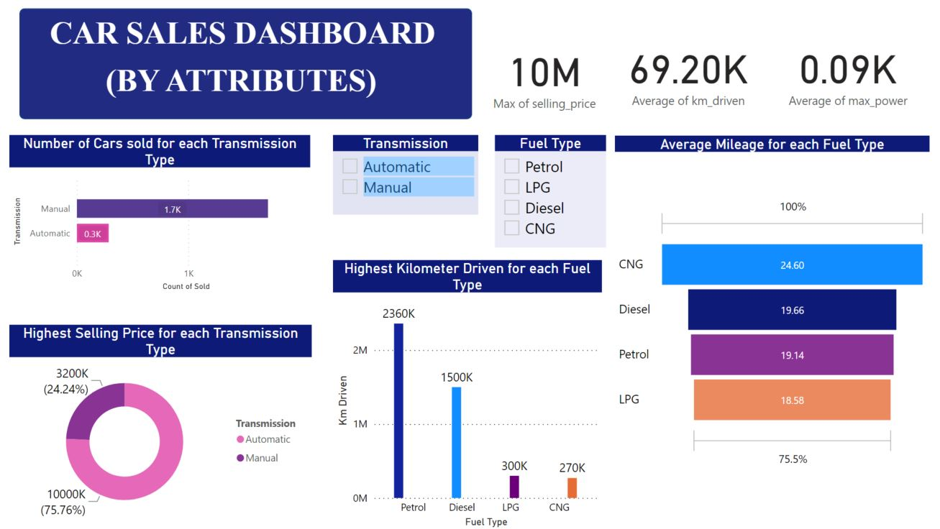

Slide 43
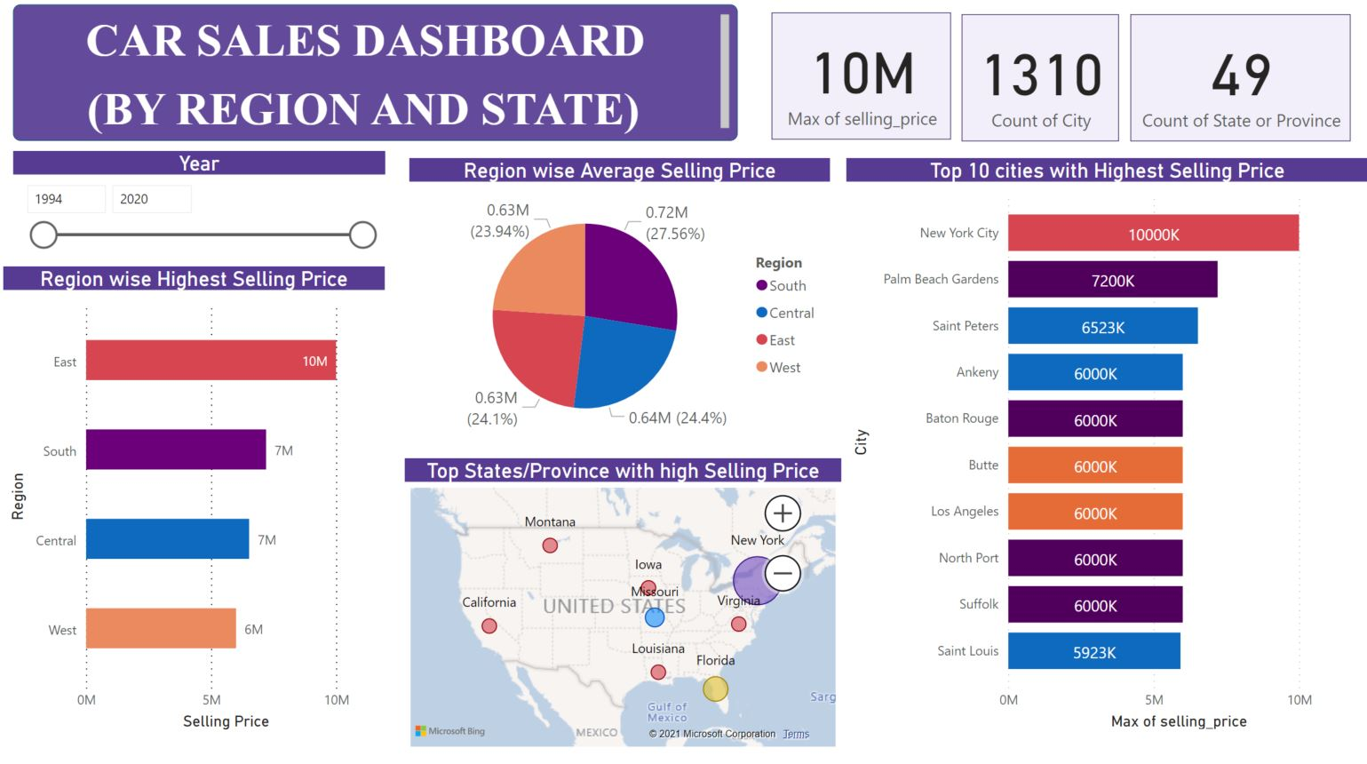

Slide 44
Suggestion to Marketing Team
Prefer buying cars having 4,5 or 7 seats.
Vehicles brought should belong to first or second owners.
Petrol and diesel cars have high selling ratio than CNG and LPG
The prospective customers may have different wants and needs so while cars like Maruti and Tata having good mileage and longevity are selling more but Mercedes and Land Rover that have the power and comfort are sold respective to their total numbers in the market.
Making more innovative strategies for those segments where cars are being sold less, or number of customers interested is less.

Slide 45

Model Building using ML Algorithms

Slide 46
Comparison Variables for ML Algorithms
R2 Score → It is a metric that tells the performance of your model, not the loss in an absolute sense that how many wells did your model perform. R2 score value is between 0 and 1 and higher the value is the better is the explanation.
Mean Squared Error(MSE) → It represents the squared distance between actual and predicted values. we perform squared to avoid the cancellation of negative terms and it is the benefit of MSE. Lower the value the better the result of the model.
Root Mean Squared Error(RMSE) → As RMSE is clear by the name itself, that it is a simple square root of mean squared error. It quantifies the error in the units of the target variable and so it is a better measure of goodness of fit than a correlation coefficient.

Slide 47
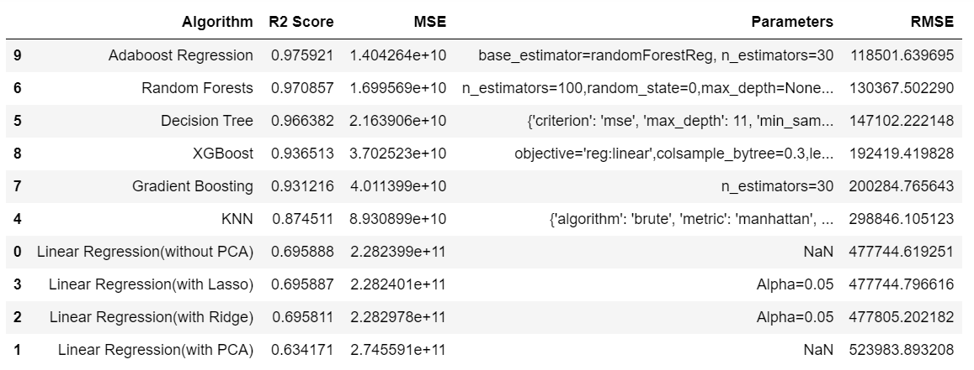
Comparison of Different Models

Slide 48
3.1
Data Analysis using Big Data Tools(HDFS, HIVE and PySpark)
3.2
Data Analysis on Cloud(AWS)
3.3
Deployment of Model using Flask

Slide 49

Data Analysis Using Big Data Tools

Slide 50



PySpark Initialization and Data Loading

Slide 51






Cleaning, Handling Missing Data and Data Transformation

Slide 52




Loading Data on Spark Data Frame and saving it to Hive tables on a Hadoop Cluster

Slide 53
Machine Learning in PySpark
Root Mean Square Error:
Mean Absolute Error:
R2 Score:
Using Random Forest Regression:
Label → Selling Price.
Train-Test Split → 70-30
Max Bins → 200

Slide 54
Machine Learning (continued)
Root Mean Square Error:
Mean Absolute Error:
R2 Score:
Using Decision Tree Regression:
Label → Selling Price.
Train-Test Split → 70-30
Max Bins → 100

Slide 55
Machine Learning (continued)
Root Mean Square Error:
Mean Absolute Error:
R2 Score:
Using Linear Regression:
Label → Selling Price.
Train-Test Split → 70-30
Max Iteration → 10
Regression Parameter → 0.01 (Ridge)

Slide 56

Data Analysis on Cloud (AWS)

Slide 57



Bucket and Folder Creation

Slide 58

Data File Upload in S3

Slide 59

Redshift Connection

Slide 60

Table creation in Redshift

Slide 61

Copying Data from S3 to Redshift

Slide 62

Creating and Loading Data in Athena

Slide 63

Query result in Athena

Slide 64


Connecting to Power BI using Redshift

Slide 65

Loading Data in Power BI

Slide 66
Storytelling using Power BI

Slide 67


Slide 68


Slide 69
Deployment of ML Model using Flask

Slide 70


Slide 71


Slide 72
Roadmap
1st Week
3rd Week
5th Week
7th Week
Understanding the Data Domain and Data Set and using Python for Data Manipulation
Data Visualization using Python and EDA
Model Building using Machine Learning
Testing and Data Analysis on Cloud
2nd Week
4th Week
6th Week
8th Week
Analysis using SQL and Python for Statistics and Hypothesis Testing
Visualization using Power BI and Model Building using Machine Learning
Review the ML Algorithms and Data Analysis using Big Data Tools
Deployment of Models using Flask
Present Checkpoint

Slide 73
Project Repository

Slide 74
Thank you

Slide 75
Q & A

